Slide 1


10
Programming Based on Events
C# Programming: From Problem Analysis to Program Design
3rd Edition

Slide 2
Chapter Outline
More on Event Handling
More Controls: CheckBox
More Controls: RadioButton
More Controls: ListBox
More Controls: ComboBox

Slide 3
1. More on Event Handling
When you double-click on a Button control object during design, Visual Studio does the following:
Click event is registered as being of interest
An event-handler method heading for the Click event is generated
These 2 steps form a event wiring process

Slide 4
2. More Controls: CheckBox
Property:
Text
Checked – either true or false depending on whether a check mark appears or not
Event:
CheckChanged( ) – fired when CheckBox object state changes

Slide 5
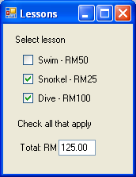
More Controls: CheckBox
Form1
lblSelect
cbxSwim
cbxSnorkel
cbxDive
lblMessage
lblTotal
tbxTotal

Slide 6
More Controls: CheckBox
Control | Property | Value
Form1 | Text | Lessons
lblSelect | Text | Select lesson
lblMessage | Text | Check all that apply
lblTotal | Text | Total RM
cbxSwim | Text | Swim – RM50
cbxSnorkel | Text | Snorkel – RM25
cbxDive | Text | Dive – RM100

Slide 7
More Controls: CheckBox
using System;
using System.Windows.Forms;
namespace WindowsExample1
{
public partial class Form1 : Form
{
public Form1()
{
InitializeComponent();
}

Slide 8
More Controls: CheckBox
private void cbxSwim_CheckedChanged(
object sender, EventArgs e)
{
ComputeCost();
}
private void cbxSnorkel_CheckedChanged(
object sender, EventArgs e)
{
ComputeCost();
}

Slide 9
More Controls: CheckBox
private void cbxDive_CheckedChanged(
object sender, EventArgs e)
{
ComputeCost();
}
private void ComputeCost()
{
double total = 0.0;

Slide 10
More Controls: CheckBox
if (cbxSwim.Checked)
total += 50.0;
if (cbxSnorkel.Checked)
total += 25.0;
if (cbxDive.Checked)
total += 100.0;
tbxTotal.Text =
string.Format("{0:F2}", total);
}
}
}

Slide 11
3. More Controls: RadioButton
Property:
Text
Checked – either true or false depending on whether a check mark appears or not
Event:
CheckChanged( ) – fired when RadioButton object state changes

Slide 12
More Controls: RadioButton
Radio buttons are normally placed together in a group
We can use a GroupBox control (which is a Container control) to do this
GroupBox Property:
Text
By default, when the application starts, the first RadioButton object in the group is selected

Slide 13
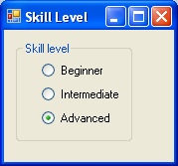
More Controls: RadioButton
Form1
groupBox
rbnBeginner
rbnIntermediate
rbnAdvanced

Slide 14
More Controls: RadioButton
Control | Property | Value
Form1 | Text | Skill Level
groupBox | Text | Skill level
rbnBeginner | Text | Beginner
rbnIntermediate | Text | Intermediate
rbnAdvanced | Text | Advanced

Slide 15
More Controls: RadioButton
using System;
using System.Windows.Forms;
namespace WindowsExample2
{
public partial class Form1 : Form
{
public Form1()
{
InitializeComponent();
}
private void rbnBeginner_CheckedChanged(
object sender, EventArgs e)

Slide 16
More Controls: RadioButton
{
if (rbnBeginner.Checked)
MessageBox.Show("Beginner selected");
}
private void rbnIntermediate_CheckedChanged(
object sender, EventArgs e)
{
if (rbnIntermediate.Checked)
MessageBox.Show("Intermediate selected");
}

Slide 17
More Controls: RadioButton
private void rbnAdvanced_CheckedChanged(
object sender, EventArgs e)
{
if (rbnAdvanced.Checked)
MessageBox.Show("Advanced selected");
}
}
}

Slide 18
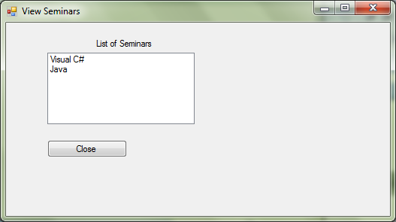
More Controls: ListBox
lbxSeminars

Slide 19
More Controls: ListBox
private void SeminarViewForm_Load(
object sender, EventArgs e)
{
Seminar[] seminarList =
controller.SeminarList;
int number = controller.NumberOfSeminars;
for (int i = 0; i < number; i++)
lbxSeminars.Items.Add(seminarList[i].Title);
}

Slide 20
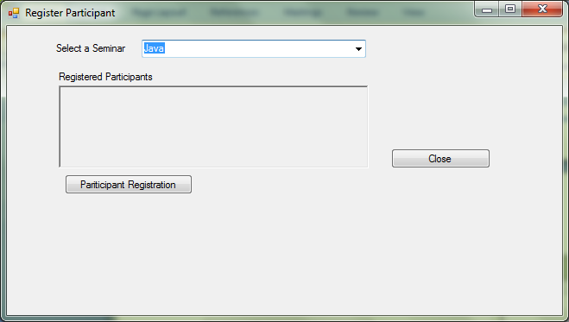
More Controls: ComboBox
cmbSeminar
rtbParticipants (RichTextBox)

Slide 21
More Controls: ComboBox
private void SeminarRegisterForm_Load(
object sender, EventArgs e)
{
for (int i = 0; i < numberOfSeminars; i++)
cmbSeminar.Items.Add(seminarList[i].Title);
cmbSeminar.SelectedIndex = 0;
selectedSeminar = seminarList[0];
}

Slide 22
More Controls: ComboBox
private void cmbSeminar_SelectedIndexChanged(
object sender, EventArgs e)
{
int selectedIndex = cmbSeminar.SelectedIndex;
selectedSeminar = seminarList[selectedIndex];
Participant[] participants =
selectedSeminar.ParticipantList;
int numberOfParticpants =
selectedSeminar.NumberOfParticipants;

Slide 23
More Controls: ComboBox
string textRows = "";
string oneRow = "";
for (int i = 0; i < numberOfParticpants; i++)
{
oneRow = participants[i].Name + " ("
+ participants[i].IcNumber + ")\n";
textRows = textRows + oneRow;
}
rtbRegisteredParticipants.Text = textRows;
}

